Slide 1
Cyberspace Trapping The Offensive Defender

Slide 2

whoami
Former Air Force
Pentester for BHIS
Founder Open Security
Instructor with the SANS Institute
Author of the SEC460 Course

Slide 3

I am Red
Offensive Perspective is Critical for Defense
This is True for Defense Software Vendors as too!
Targeting Threat Tactics Requires Intimate Understanding

Slide 4
Losing is Inevitable
Defense Needs to Be Successful 100% Offense just Needs to Win Once

Slide 5
Losing is Inevitable
The quickest way to lose is to cede victory
It stifles Creative Thinking
It’s the Easy Way Out
If a Catastrophic Breach Feels Inevitable how can we Change this?
Military Science gives us Parallels from which to Learn

Slide 6
Introspection
Is your Defense at the Boundary or Behind it?
Do you know how your Vendor Tools Work?
Breaches Happen!
The Maginot Line Style of Defense is Outdated and Dangerous
It is Time to Invest and Empower People to Customize Defense

Slide 7
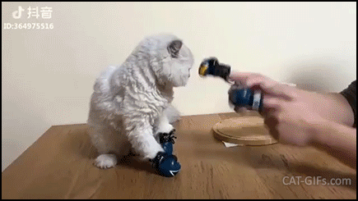
Fighting the Right Fight
Is your Defensive Strategy Targeted to Address True Threats?

Slide 8

Cyberspace Trapping
It’s not You it’s Me
Poison vs Venom
Cyberspace trapping is the practice of poisoning threat Tactics, Techniques, and Procedures in order to weaponize your environment

Slide 9
Tactics, Techniques, and Procedures (TTP)
TTP is a widely used term in the information security community but many misuse or incorrectly delineate the term.
Tactics - "The employment and ordered arrangement of forces in relation to each other. See also procedures; techniques."
Techniques - "Non-prescriptive ways or methods used to perform missions, functions, or tasks. See also procedures; tactics."
Procedures - "Standard, detailed steps that prescribe how to perform specific tasks. See also tactics; techniques."

Slide 10
Know thy self, know thy enemy. A thousand battles, a thousand victories

Slide 11
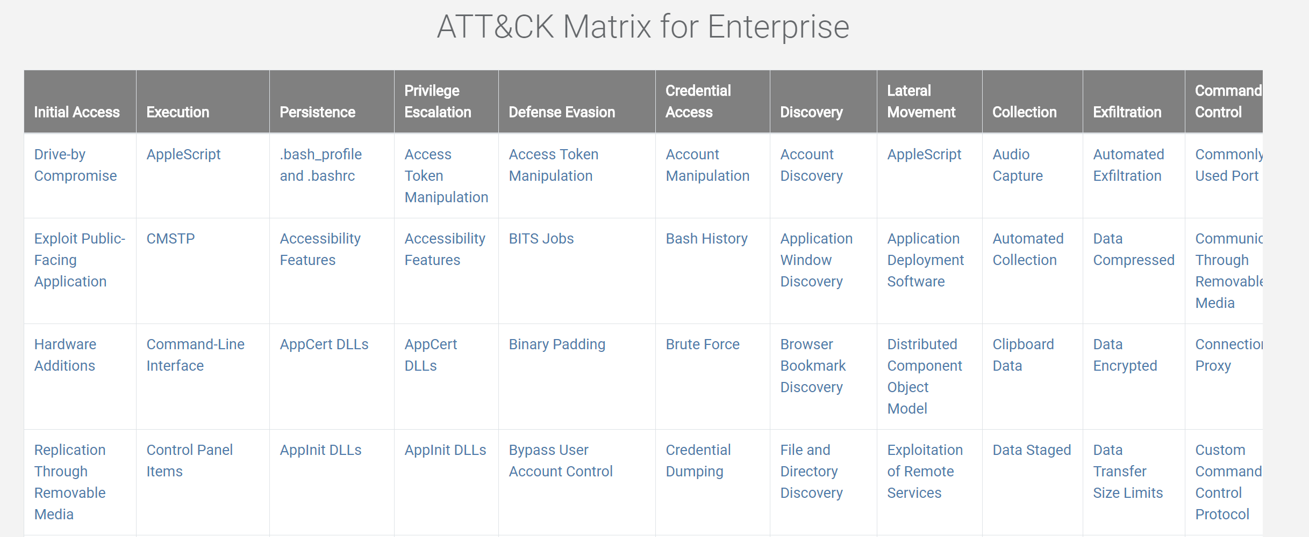
Finding Threat TTP
MITRE ATT&CK

Slide 12
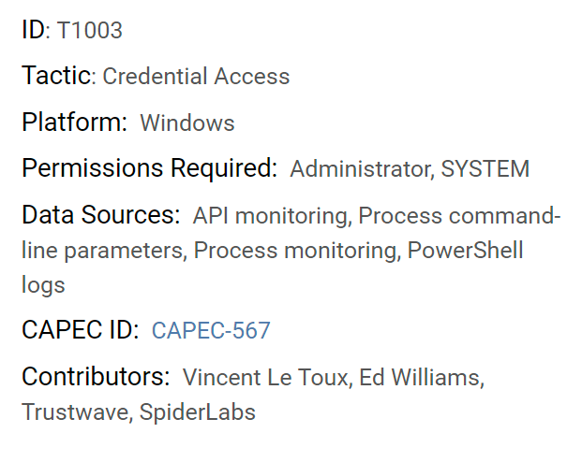
Mimikatz and LSASS Passwords
According to the NSA Red Team Mimikatz is the number one threat to US Government Environments

Slide 13
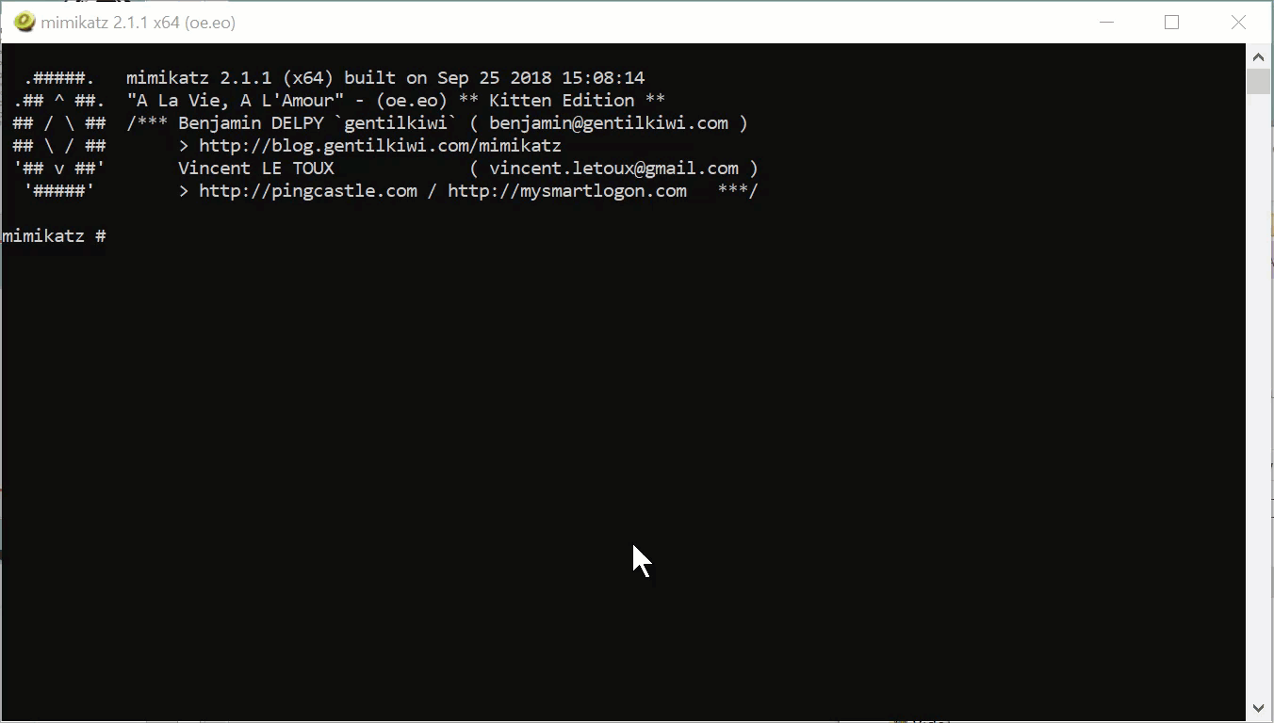
Mimikatz

Slide 14
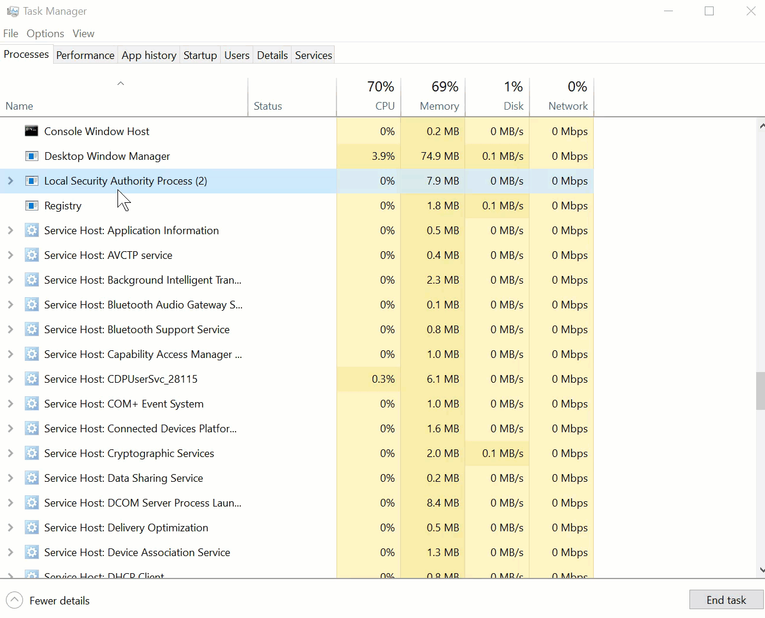
Task Manager LSASS Dump

Slide 15
Other Mimikatz Implementations
PowerShell
Cobalt Strike
C#
Metasploit
Many Many Others

Slide 16
Poisoning LSASS
Tactic
Escalate privileges to domain admin using stolen credentials
Technique
Use Mimikatz to retrieve credentials from LSASS memory
Procedures
Steps to accomplish the techniques mentioned above
Traditional Defense
Do more user awareness training
Write a Mimikatz signature and pray
Cyberspace Trapping
Create fake accounts configured to lockout after one failed attempt
Use RunAs to seed LSASS with fake creds

Slide 17
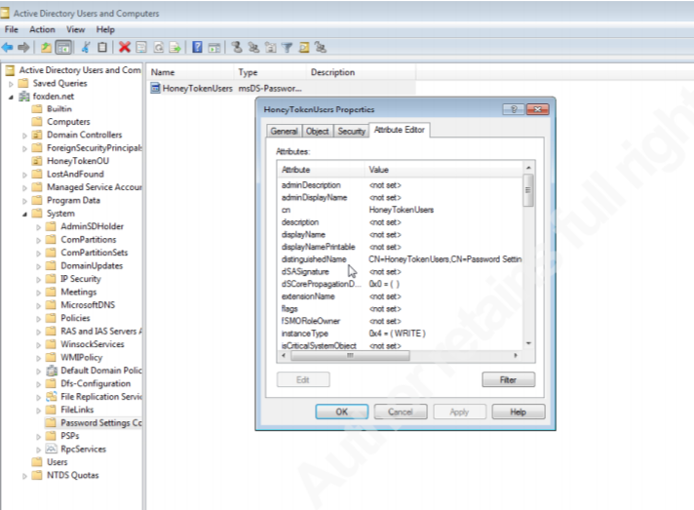
Configuring Fine-Grained Password Policies

Slide 18
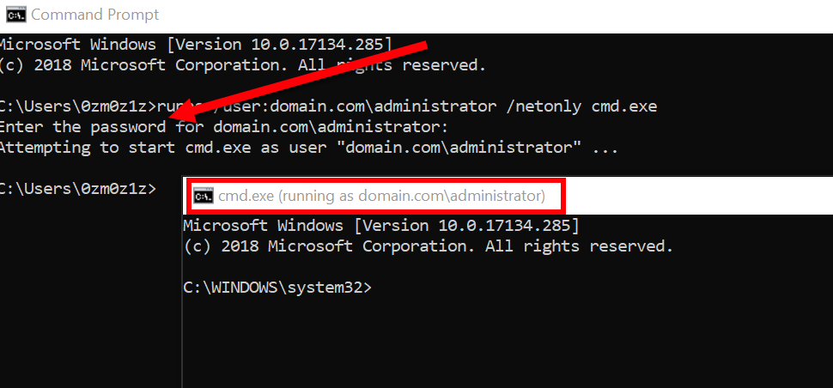
Sneaking Fake Credentials into LSASS
runas /user:domain.com\admin /netonly cmd.exe

Slide 19
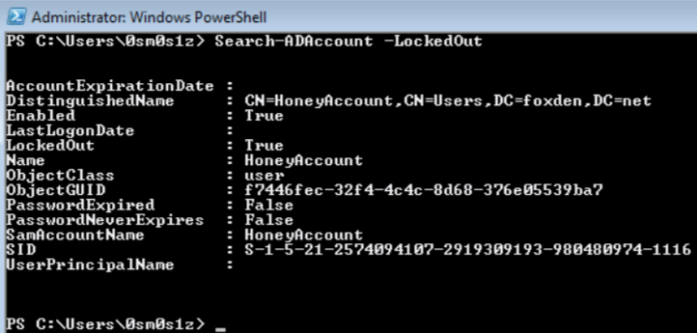
Monitoring and Scaling with PowerShell
Tracking LockedOut Status Provides us with Additional Sensors within the Environment
Correlating this Information with the IP Address of the system where the Trap is in Place Allows for Increased Reaction Speed

Slide 20
Other Implementations
Passwords.txt Files
Poisoned Password Managers
Network Passwords
Telnet
FTP
HTTP
The threat actor can no longer know whether to trust the password gifts of careless users. They might just be poisoned.

Slide 21
Trap Master 101
Pretend inferiority and encourage his arrogance.

Slide 22

The OODA Loop
When the Threat can no Longer Trust their Own Tools Their ability to Decide has been Distrupted

Slide 23
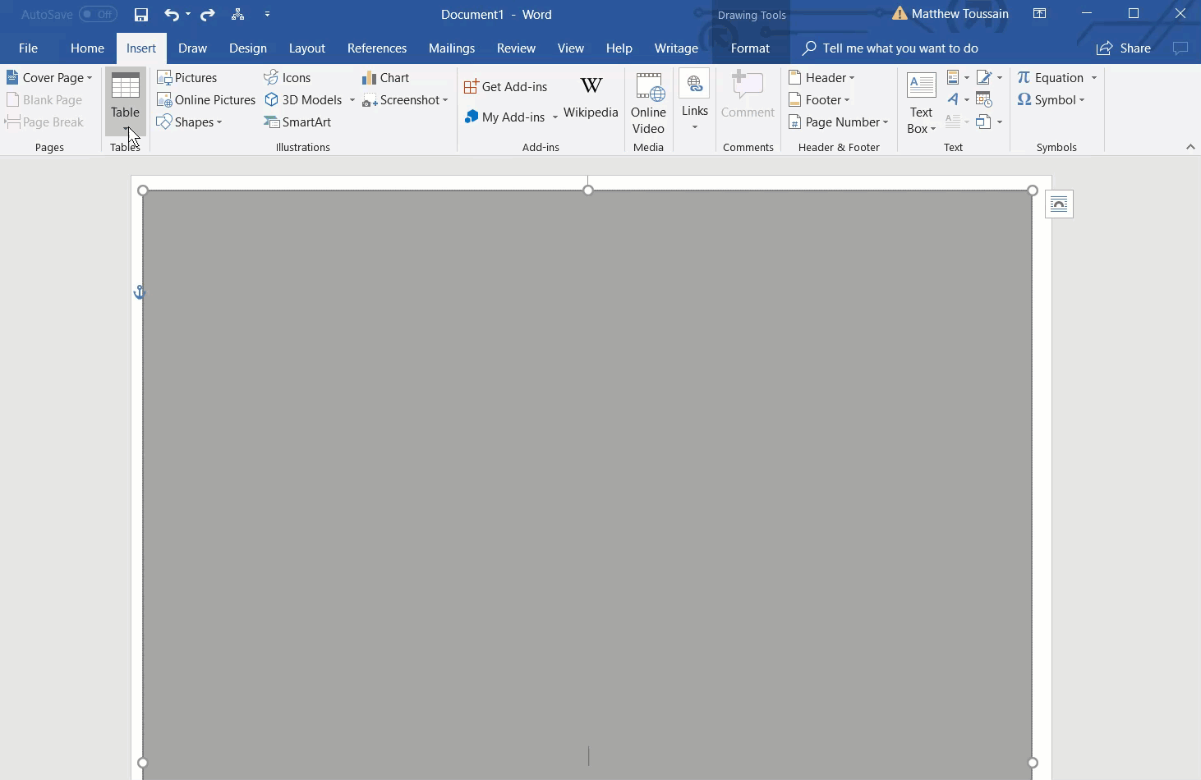
Poisoning Documents

Slide 24
Other Traps
Fake Login Portals
Site Cloning
Robots.txt Disallowed References
Port Traps
Decoy Shared Drives
Local Admin Access Group Traps
Many More

Slide 25
Traps vs Honeypots
Traps are Built to Poison Adversary Tactics to Produce Indicators of Compromise
Because the Trap is Based on Fake Information they are Difficult to Turn Against You
Honeypots Collect Threat Intelligence by Providing a Low-Risk Target for Adversary Exploitation

Slide 26

Intel Gain/Loss
Threat Intelligence is Vital, but Most Commercial Feeds are Pure Snake Oil
Personalized Indicators of Compromise are the only Valid Ones
In the Private Sector we are Extremely Quick to Burn our Threat Intelligence

Slide 27
Cyberspace Trapping
Cyberspace Trapping is an aggressive strategy for defense
The objective is not to block attacks
Blocking all attacks, you can see, leaves fewer options to identify the attacks you cannot
Poison the root of their methodology
Then follow the effects along the tree until you see fruit they are after and deny them.
Engaging adversaries by tactic as opposed to tool is not a static, trivially bypass-able defense like AV signatures
When the opponent is uncertain they are vulnerable. When deceived they are weak. Cyberspace trapping about sowing confusion, disorder, and chaos along the attacker’s path

Slide 28
Questions?
Matthew Toussain | @0sm0s1z | http://github.com/0sm0s1z/CyberspaceTrapping

